Slide 1
Automated insider threat detection system using user and role-based profile assessment
By: Jordan Donovan

Slide 2
Introduction
Insider threats are a growing problem wherein individuals within an organization pose a threat to the operation of the business.
Three main types:
Technology sabotage
Theft of intellectual property
Data fraud
Much of the organizations data and activities are supported by technological means
This activity and data can be captured and analyzed
Anomalies can be found by observing daily activities and calculating anomaly assessment scores for these activities

Slide 3
Related Work
Variety of different models to detect or prevent insider threats
Psychological and behavioral characteristics
Policy violations
Hierarchical and threshold secret sharing
Methods of detection
Honeypots
Profiles of user behavior
Server log data
Violation of need-to-know policies
Social graphs
Use of real-world data to detect similarities in user profiles to insider threats of the past

Slide 4
Requirements Analysis
Score for each user representing the threat he/she currently poses
Deal with multiple forms of threats
Deal with unknown cases of insider threat (anomalous)
Assess threat of individual based on behavior

Slide 5
System Overview
Key components
Retrieval of records from organizational database
User and role based profiling
Profile feature extraction
Anomaly assessment from features
Classification of threat from anomaly scores

Slide 6
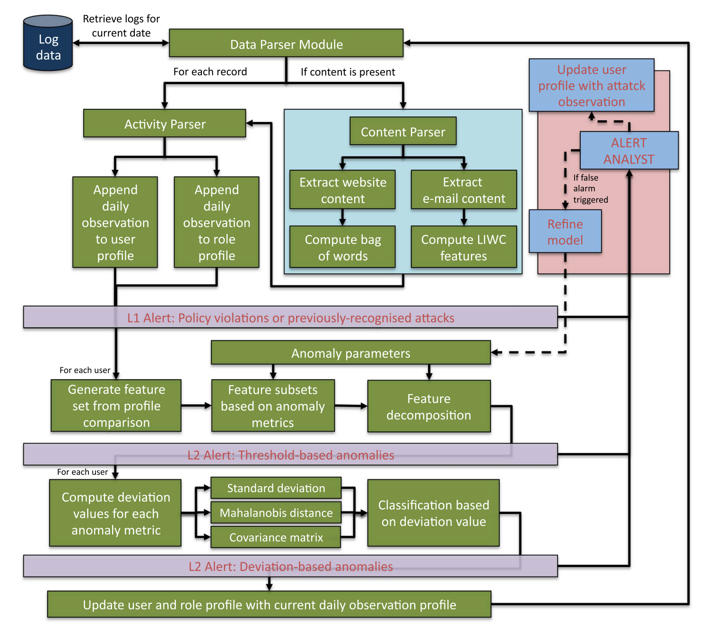
System Overview Cont.

Slide 7
System Overview – Data Input
Logging of five type of activities
Login, USB device, E-mail, Web, and File accessed
Each of the activities contains information on
Timestamp, User ID, Device ID, and Activity name
Some activities also contain attributes which also can trigger the Content Parser for the final property of the record
Example: E-mail recipients, filename accessed, website accessed
Linguistic Inquiry Word Count (LIWC) and bag-of-words can both be used to analyze textual data

Slide 8
System Overview – User and Role-Based Profiling
Tree Structured Profile
Based on user and role
Describes different devices, activities, and attributes
Three child nodes:
Daily, Normal, and Suspicious (Attack)
Three levels
Devices -> Activities Performed -> Attributes (if applicable)
Each node maintains a 24 bin histogram denoting usage for each hour of the day
A rule-based approach to compare activities to company policy or previous attack patterns can be constructed
If no flags up to this point, then we proceed with Feature Extraction

Slide 9
System Overview – Feature Extraction
Series of features considering new observations for the user compared against their previous activity and the previous activity of his/her user role
Series of features assessing hourly and daily usage counts
Series of time-based features
All of the above assess devices, activities, and features within
Assessment of three key areas
User’s daily observations
Comparison of user’s daily activity compared to his/her previous activity
Comparison of user’s daily activity and the activity of his/her role

Slide 10
System Overview – Threat Assessment
Map features for all previous days as well as current day
Using PCA project features into lower-dimensional space
Allow a weight for each feature
Visualize all features into feature space
Calculate difference in current feature set to visualized feature set – This is our anomaly score
This is performed for each anomaly metric
Anomaly metrics considered
Login_anomaly, Login_duration_anomaly, Logoff_anomaly, USB_inserstion_anomaly, USB_duration_anomaly, Email_anomaly, Web_anomaly, File_anomaly, This_anomaly, Any_anomaly, New_anomaly, Hourly_anomaly, Number_anomaly, User_anomaly, Role_anomaly, and Total_anomaly.
This allows for us to discover the user posing the threat and also the attack vectors they are acting

Slide 11
System Overview – Classification of Threat
Using two standard deviations as norm
Compute Mahalanobis Distance to assess observed distance of user from the rest of the distribution
Covariance distance of a user’s anomaly scores and each day assess signed differences between covariances
Other methods can also be used to flag a user’s behavior

Slide 12
Experimentation
Data for all employees for 365 days is generated and attack data is inserted into roles after the first 15 days
Activities for employees correspond to previous previously observed attacks
Normal activity was auto-generated and attack data was manually inserted
Auto-generated data was not all the same but within a boundary
An entire attack scenario was written and malicious activity inserted into the logs
Malicious data inserted related to employee’s behavior but not their role

Slide 13
Experimentation - Results
Level-2 and Level-3 alerts are defined
Best results from scenario 3
4200 daily assessments
24 flagged as anomalies
All ten days of malicious activity are present in 24 flagged anomaly days
42% precision and 100% recall
Serves to filter out much activity that is not anomalous

Slide 14
Conclusion and Future Work
Data logs and input are created
Profiles are generate for each user and role
Features are extracted from profiles
Threats are assessed
Threats are classified
This experiment had 100% detection (42% precision)
Future Work
Work with several models
Experimenting with real-world data
Decomposition to different levels of dimensionality

